Slide 1
Chapter 7
Direct Current Machines
7.1 Fundamentals
7.2 No Load Magnetic Field
7.3 Armature Winding and Armature Reaction
7.4 Emf and Electromagnetic Torque in Armature Winding
7.5 DC Generator

Slide 2
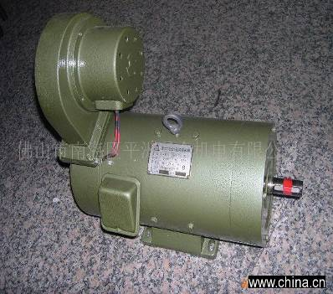
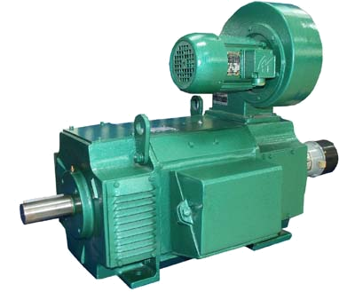
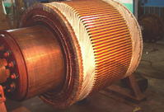
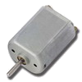
7.1 fundamentals
7.1.1 Generating an ac voltage
7.1.2 DC generator
7.1.3 DC motor
7.1.4 Construction
7.1.5 Name plate data

Slide 3
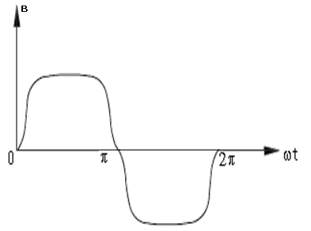
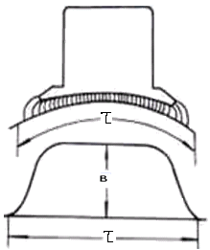
7.1.1 Generating an ac voltage

Slide 4
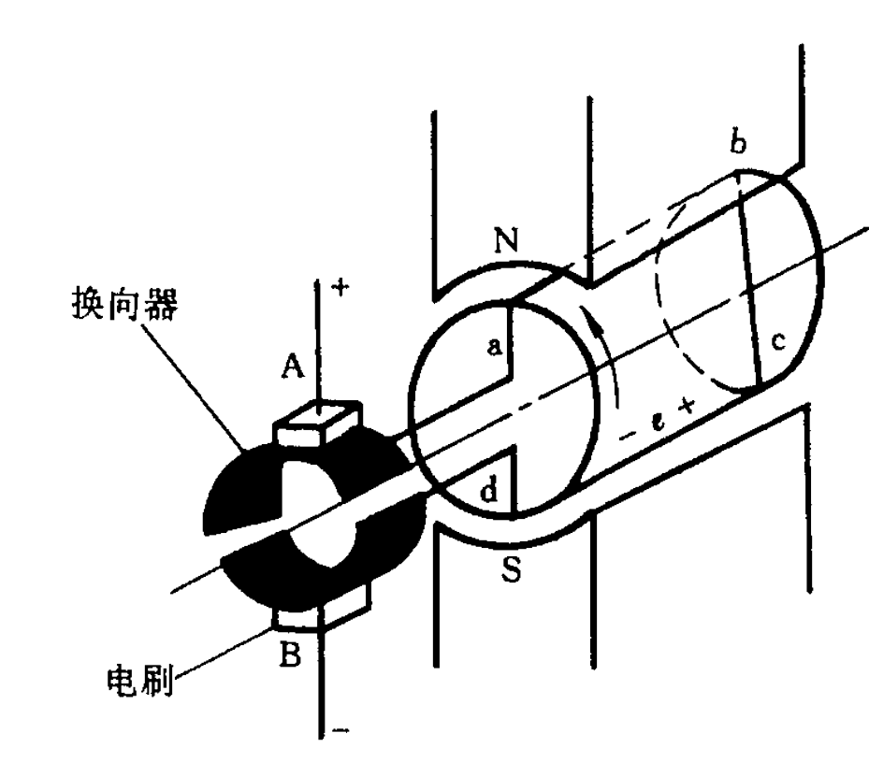
7.1.2 DC generator
Winding
绕组
The simplest possible rotating dc machine is shown in figure 7-1
It consists of a single loop of wire rotating about a fixed axis. The rotating part of this machine is called rotor ,and the stationary part is called stator.
Main poles
主磁极
commutators
brushes
Figure 7-1

Slide 5
7.1.2 DC generator
As the coil rotates, a voltage is induced between its terminals. This voltage is connected to the brushes A and B, and therefore, across the load. The induced voltage is therefore maximum when the coil is momentarily in the vertical position; and zero when the coil is momentarily in the horizontal position.
Winding
绕组
Main poles
主磁极
commutators
brushes
Figure 7-1

Slide 6
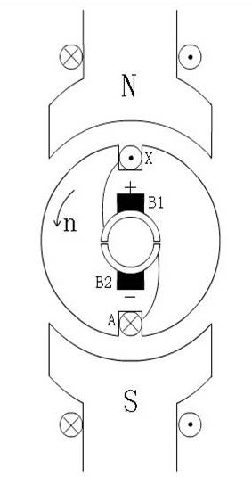
7.1.2 DC generator
This figure is that its polarity changes every time the coil makes half a turn. The voltage can therefore be represented as a function of the angle of rotation. The waveform depends upon the shape of the N,S poles.
Brushes
Commutator
Armature core
Main poles
Figure 7-2

Slide 7
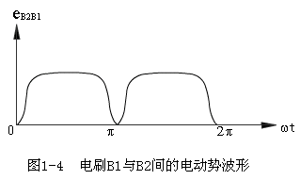
7.1.2 DC generator
We assume the poles were designed to generate the wave. Because each angle of rotation corresponds to a specific interval of time, we can represent the induced voltages as a function of time as in Figure 7-3.
Figure 7-3

Slide 8
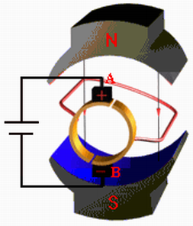
7.1.3 DC motor
In the Figure 7-1, if a power supply is provided across the brushes A and B, and a current is produced in the coil, the conductors carrying the current will subject to a force to drive the coil to rotate, which is a dc motor operation.
The simplest possible dc motor is shown in Figure 7-4.
Figure 7-4

Slide 9
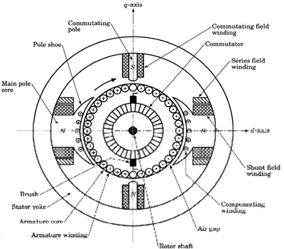
7.1.4 construction

Slide 10
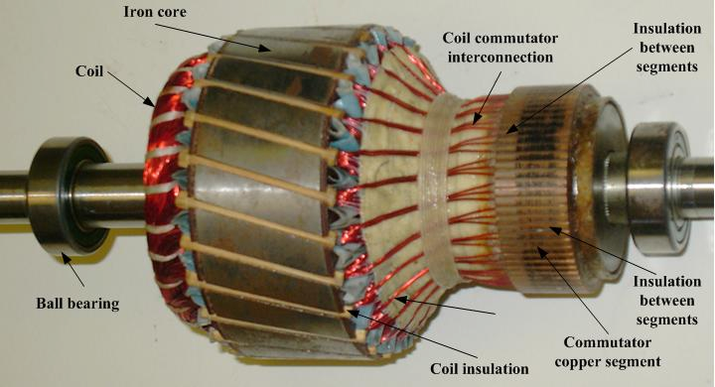
7.1.4 construction
Figure 7-6 is a real rotor of a dc machine.
Figure 7-6

Slide 11
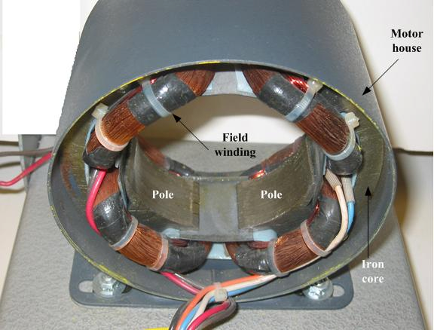
7.1.4 construction
Figure 7-7 shows a real 4-pole stator.
Figure 7-7

Slide 12

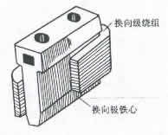
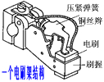
7.1.4 construction
The main section of stator
main pole core interpole brush

Slide 13
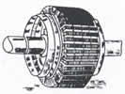
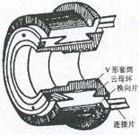
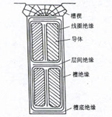
7.1.4 construction
The main section of rotor
armature corn armature winding commutator

Slide 14
7.1.5 Name plate data
A name plate gives the rating information about a machine, and if a machine is running at the rated condition, the performance will be better.
Rated power (w or kW): defined as output power. For a generator, it is the output electrical power; and for a motor, it is the output mechanical power on shaft.
Rated voltage (V): defined as the armature voltage under the rated condition.
Rated current (A): defined as the armature current under the rated condition. A dc machine can not be running for a long time at over-rated current, which will burn the machine.

Slide 15
7.1.5 Name plate data
Rated speed (rpm): defined as the rotor speed under the rated condition.
Rated efficiency (Hz): defined as the ratio of output power to input power under the rated condition.
Excitation mode: shunt machine, series machine or compound machine.
Rated excitation data: rated excitation voltage, excitation current, ect.
Insulation class: Class A, E, B etc.
Rated temperature rise: impose the temperature limit.

Slide 16
7.2 No Load Magnetic Field
7.2.1 Magnetization Characteristic
7.2.2 Flux Density Distribution

Slide 17
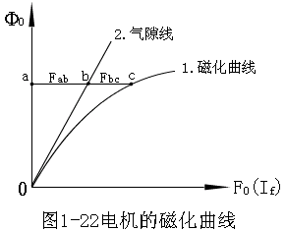
7.2.1 Magnetization Characteristic
Magnetization Characteristic
The flux is produced by the field current, and the Ф = f(If) is the magnetization curve as shown in figure
Figure 7-8

Slide 18
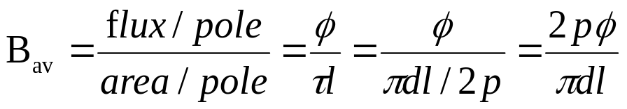
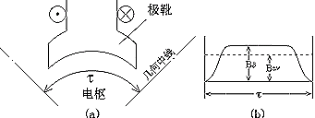
7.2.2 Flux density distribution
Figure 7-9

Slide 19
7.3 Armature Winding and Armature Reaction
7.3.1 Some Terms in Armature Winding
7.3.2 Simple Lap Winding
7.3.3 Armature MMF and DC Machine Magnetic Field
7.3.4 Armature Reaction when Brushes at Geometrical Neutral Line

Slide 20
7.3.1 Some terms in armature winding
1.Pole axis: is defined as the middle line of a magnetic pole;
2.Geometric neutral line: is the middle line between two addjacent poles；
3.Number of slots Z: is the total number of slots around the full rotor circumference.
4.Pole pitch: is the distance between two adjacent geometric neutral line.

Slide 21
7.3.1 Some terms in armature winding
5.Coil:is a basic element of armature winding. It can have one turn and multi-turns, and its two terminals, starting terminal and end terminal, will connect to two different commutator segments separately.
6.Coil pitch: represents the distance between the two effective sides, numbered by slots, because the sides of a coil must be placed in slots, so it must be an integer.

Slide 22
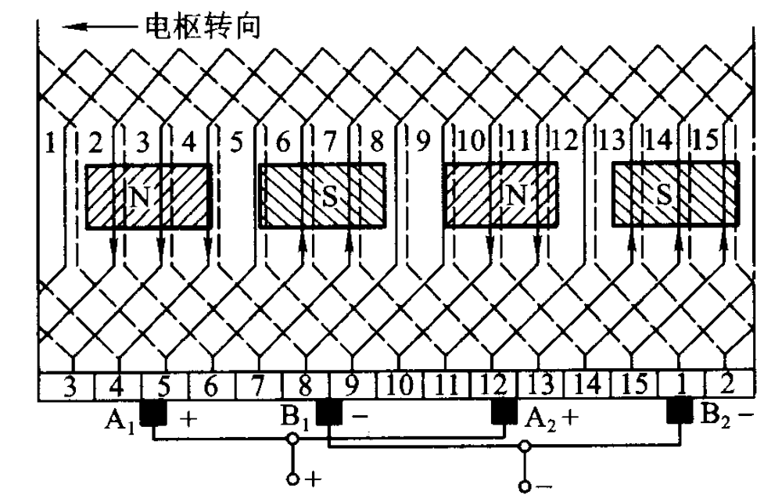
7.3.2 Simple lap winding
The best way to understand the simple lap winding is to design it through an example.
Example:
design a simple lap winding with Z=16 slots and 2p=4 poles.
Figure 7-10

Slide 23
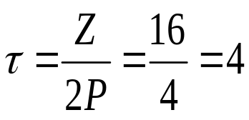
7.3.2 Simple lap winding
Solution ：
1. Calculate:
2. Draw the winding:
1).Draw 16slots, and number them.
2).Draw 16 coils one by one, series connected into a loop.
3).Draw commutator segments, connected to coil terminals.
Figure 7-10

Slide 24
7.3.2 Simple lap winding
4).Draw poles, evenly distributed, and assign the poles by N and S.
5).Assume motion direction.
6).Determine the direction of induced emf.
7).Place brushes:
8).Connecting the brushes terminals to complete the armature winding as in figure 7-9.
Figure 7-10

Slide 25

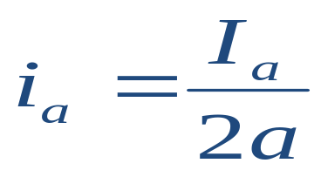
7.3.2 Simple lap winding
Conclusion :
1.The coils under each magnetic pole consist of one branch, so for a 4-pole dc machine with simple lap winding, there are four branches.
2.The four emfs in the four branches are identical.
3.These four emfs are paralleled connected.
4.The emf appears at the brushes, which are connected to the external terminals
5.The terminal current is the sum of the currents in the four branches.
Where ----branch current;
a ----number of branch pair;

Slide 26
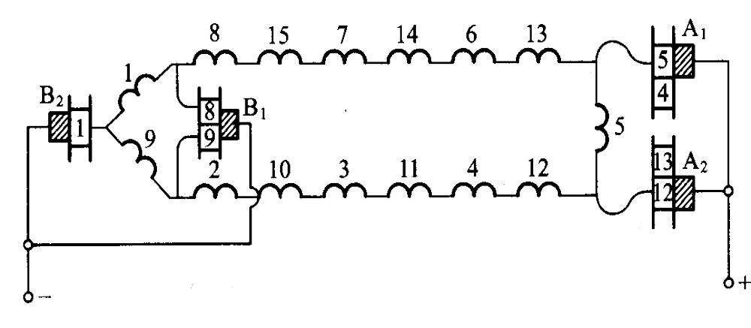
7.3.2 Simple lap winding
The diagram of parallel branches
Figure 7-11

Slide 27


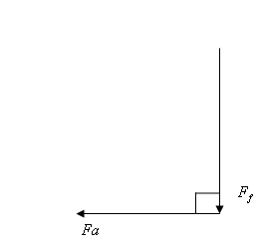
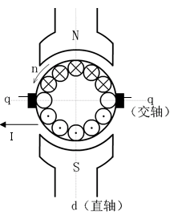
7.3.3 Armature mmf and dc machine field
AS stated above, the brushes are at the positions where the main pole flux density is zero and it has been known that the current directions. At the two sides of each brush are different which give rise to an armature mmf as in figure 7-12a.
This time, the dc machine magnetic field consists of main field mmf and armature mmf as shown in Figure 7-12b.
Figure 7-12a
Figure 7-12b.

Slide 28
7.3.4 Armature reaction when brushes at geometrical
neutral line
The armature mmf will distort the main magnetic field produced by the main poles as shown in Figure 7-13 the next page.
It must be noticed that when the peak value of combined flux density is large enough to make the magnetic field saturate , the armature reaction will reduce the total flux under a pole ,which is unexpected.

Slide 29
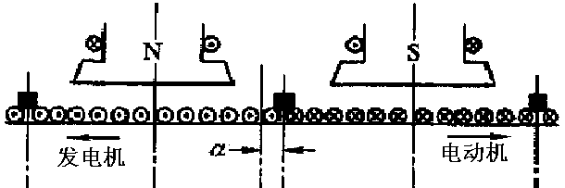
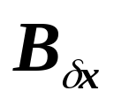
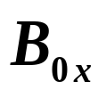
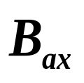
7.3.4 Armature reaction when brushes at geometrical
neutral line
电枢磁场磁通密度分布曲线
主磁场的磁通密度分布曲线
两条曲线逐点叠加后得到负载时气隙磁场的磁通密度分布曲线

Slide 30
7.4 EMF and Electromagnetic Torque in
Armature Winding
7.4.1 EMF in Armature Winding
7.4.2 Electromagnetic Torque

Slide 31

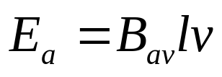
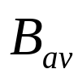

7.4.1 Emf in Armature Winding
1.emf in a conductor
An emf induced in a conductor can be express as:
(7-5)
where --------average flux density weber/meter
--------effective length meter
v --------tangential speed meter/second

Slide 32
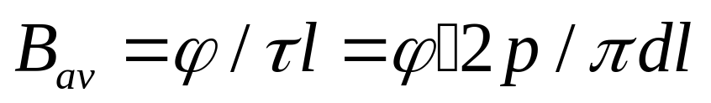

7.4.1 Emf in Armature Winding
2.The average flux density
Based on the flux curve in the figure 7-8, the average flux density is:
(7-6)
where p -------number of pole pair
-------effective length of conductor
d -------diameter where the winding conditions are fixed
-------flux per pole

Slide 33
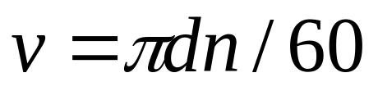
7.4.1 Emf in Armature Winding
3.The tangential speed v
If n represents the rotor speed in revolution per minute, then the tangential speed v is given by:
(7-7)

Slide 34
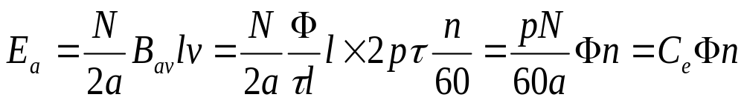

7.4.1 Emf in Armature Winding
4.Armature emf
The armature emf is:
(7-8)
where N-------number of conductors in the armature winding
-----emf costant
(7-9)

Slide 35

7.4.1 Emf in Armature Winding
From the equations (7-8), it can be seen that the induced voltage in any given machine depend on three factors:
1.The flux in the machine;
2.The speed n of the machine rotor
3.A constant depending on the construction
of the machine

Slide 36
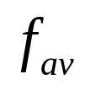
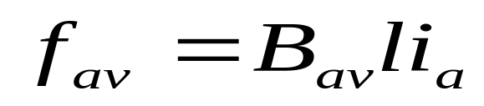

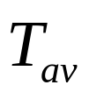
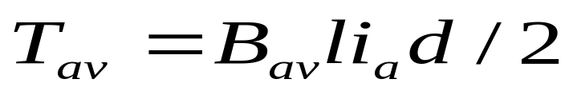
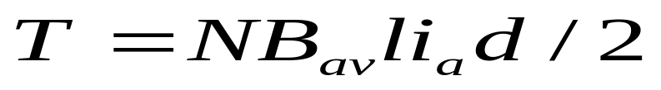
7.4.2 Electromagnetic Torque
Each conductor of an armature in the dc machine will subject to a average force , which is:
(7-10)
where ----Branch current in armature winding.
From the equation (7-10),the average torque produced by each conductor is :
(7-11)
If the total number of conductors is N, the total torque will be :
(7-12)

Slide 37
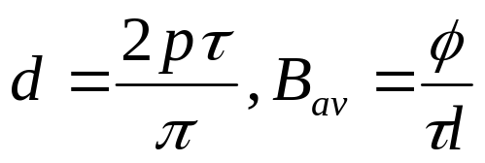
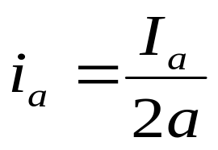
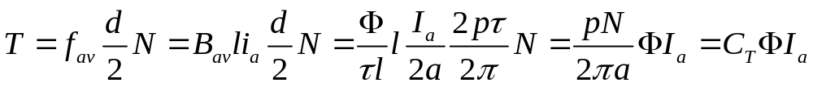
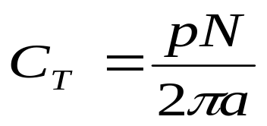
7.4.2 Electromagnetic Torque
In view of and ,
the total magnetic torque will be:
(7-13)
where , torque constant.

Slide 38


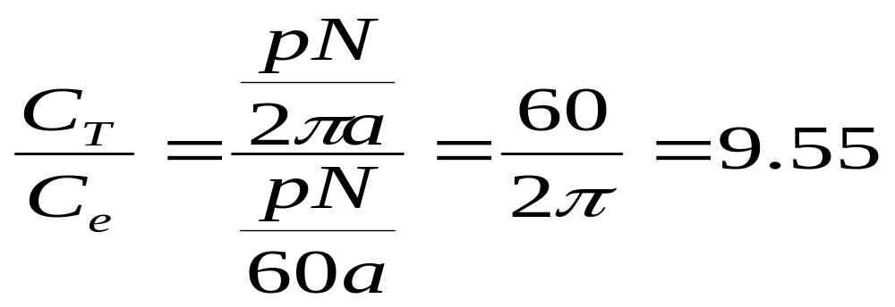
7.4.2 Electromagnetic Torque
Compare and , we have:
(7-14)
It can be seen that the ratio of torque constant to emf constant
is 9.55

Slide 39
7.6 DC Motor
7.6.1 Basic Balance Equations
7.6.2 Reversible Principle of DC Machine
7.6.3 Characteristic of Shunt Motor
7.6.4 Series DC Motor
7.6.5 The Compounded DC Motor
7.6.6 Modified Torque-speed Characteristics

Slide 40
7.6 DC Motor
Four major types of dc motors
The separately excited dc motor
The shunt dc motor
The series dc motor
The compound dc motor
I_{f}
I_{a}
I_{f}
U_{f}
M
U
U
M
U
M
U
M
他励
并励
串励
复励

Slide 41
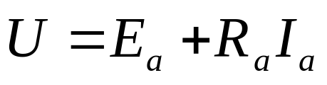
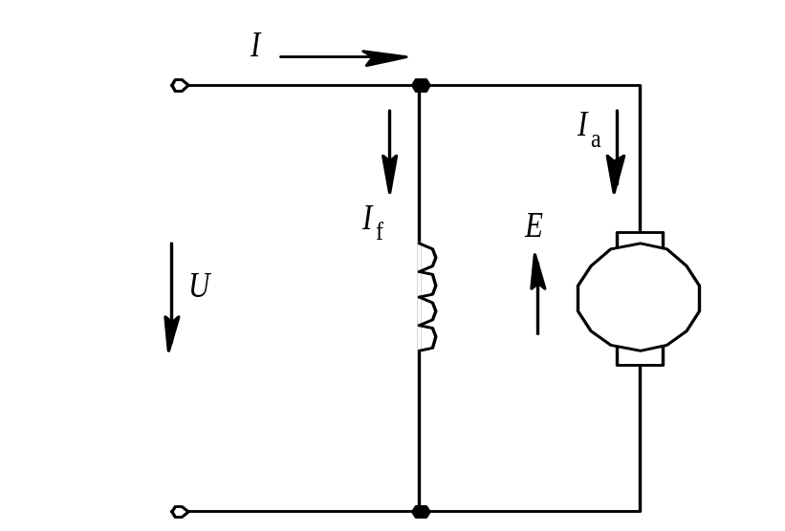
7.6.1 Basic Balance Equations
1.Voltage balance equation
M

Slide 42
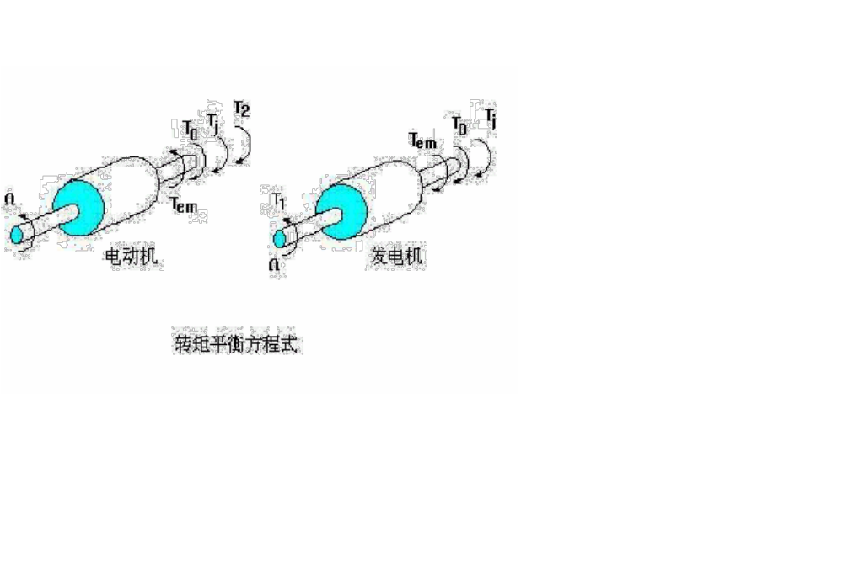
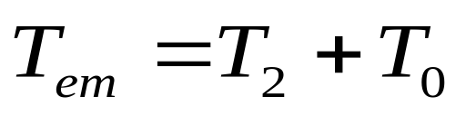

7.6.1 Basic Balance Equations
2.Torque balance equation

Slide 43



7.6.1 Basic Balance Equations
3.Power balance equation
E_{a}I_{a}=ΩT
p_{m}+p_{ad}
p_{co}
p_{fe}

Slide 44
7.6.2 Reversible Principle of dc machine
Question:
我们已经做过实验，直流电动机可以直接拿来做发电机，反之亦然。
那前面学过的三相交流电机可以吗？

Slide 45

7.6.3 Characteristics of shunt motor
1.Speed Characteristic
When U=U_{N}, I_{f}=I_{fN}, the relationship of between speed and armature current is
?
= n₀-βI_{a}

Slide 46

7.6.3 Characteristics of shunt motor
2.Torque Characteristic
When U=Un, I=Ifn, we can know
How to increase I_{a}?(U=U_{n})
T_{L} ↑
n↓
E↓
T ↑
I_{a} ↑

Slide 47







7.6.3 Characteristics of shunt motor
3.Efficiency
P_{co}+P_{f}+P_{fe}+P_{m}+P_{ad}
U(I_{a}+I_{f})
Neglect Pad and If,then
P0=Pf+Pm+Pfe=constant
When P0=Ra*Ia^2,
is max

Slide 48



7.6.3 Characteristics of shunt motor
4.Terminal Characteristic or Torque-Speed Curve
When U=U_{N} I_{f}=I_{fN}
C_{e}
C_{e}C_{T}
When T=0, n0= (theoretical no-load speed )
When T=T0 , (practical no-
load speed)

Slide 49








7.6.3 Characteristics of shunt motor
If we consider armature reaction：
With AR
No AR
Without armature reaction
With armature reaction

Slide 50
7.6.4 Series DC Moter
I_{f}
1.Torque Characteristic
The electromagnetic torque is:
T= C_{T} ΦI_{a}
E_{a}
I_{a}
U
1)The magnetic circuit is not saturated, Φ=KIf
T= C_{T} ΦI_{a}=C_{T}KI_{a}²
2)The magnetic circuit is saturated, Φ=constant
T= C_{T}K’I_{a}

Slide 51
7.6.4 Series DC Moter
2.Torque-speed curve of series motors
1)The magnetic circuit is not saturated, Φ=K*If (Ia=If)
E
=
C
Φn
=
C
K
I
n
e
e
a
T
=
C
ΦI
=
C
K
I
2
T
a
T
a
U
=
E
+
I
R
a
a

Slide 52


7.6.4 Series DC Moter
It is not allowed to be at no-load condition!!!
2)The magnetic circuit is saturated, Φ=constant

Slide 53

7.6.4 Series DC Moter
Torque – speed curve of a series motor

Slide 54

7.6.5 Compounded DC Motor
Cumulatively compounded dc motors
(积复励)
Differentially compounded dc motors
(差复励)

Slide 55

7.6.5 Compounded DC Motor
A comparison of the torque–speed characteristics of each of these types of machines is shown in the right figure.

Slide 56

7.6.5 Compounded DC Motor
A differentially compounded motor is unsuitable for any application.
It can result if the direction of power flow reverses in a cumulatively compounded generator.
The torque–speed characteristic
of a differentially compounded dc motor

Slide 57
7.6.6 Modified Torque –Speed Characteristics
1.Inherent torque-speed curve
C_{e}
C_{e}C_{T}

Slide 58





7.6.6 Modified Torque –Speed Characteristics
2.Modified T-n curve with series resistance in the armature circuit
c
c
c

Slide 59




7.6.6 Modified Torque –Speed Characteristics
3.Modified curve with terminal voltage varying
U
>
U
2
N
U
2

Slide 60



7.6.6 Modified Torque –Speed Characteristics
4.Modified curve when the field current If is reduced
n₀₁
I_{f}=U/R_{f} R_{f}
I_{f}
Φ
n₀
E
I_{a}
T
n
T >T_{L}

Slide 61





7.6.6 Modified Torque –Speed Characteristics
5.Inherent torque –speed curve from name plate data
We know Pn, Nn, Un, In
There are two points very important
(n0, T0), (nN, TN)
Summary:
1)Calculate Ra
2)Calculate Ceφ and CTφ:
3)Calculate n0
4)Calculate TN

Slide 62
7.7
Drives of Separately
Excited DC Motor
Speed
control
Breaking
Starting

Slide 63
7.7.1 Starting a DC Motor
Starting a DC motor is to increase its speed from standstill (停车) to required speed.
If we supply full voltage to a stationary shunt motor, the starting current in the armature will be very high and we run the risk of:
1) burning out the armature
2) damaging the commutator and brushes
3) overloading the feeder (power supply)
4) snapping off (突然折断) the shaft due to mechanical shock
5) damaging the driven equipment because of the sudden mechanical hammerblow (打击)

Slide 64
7.7.1 Starting a DC Motor
All DC motors must, therefore, be provided with a means to limit the starting current to reasonable values, usually between 1.5-2 full-load current. One solution is to connect a rheostat (变阻器) in series with the armature. The resistance is gradually reduced as the motor accelerates and is eventually eliminated entirely, when the machine has attained full speed.
Today electronic methods are often used to limited starting current and to provide speed control.

Slide 65
7.7.1 Starting a DC Motor
1) Decrease armature voltage
It's not allowed to supply the rated voltage directly without any protection method, but when the supplied voltage is reduced to the extend to allow only the limited current to flow, the motor can be started from zero speed. With the increasing of the speed, increase the supplied voltage gradually to meet the requirement of the starting. This has the same effect with the speed control.

Slide 66
7.7.1 Starting a DC Motor
2) Increase resistance in armature circuit
In order to protect the motor and other equipment in a DC drive system, a starting resistor can be inserted in the armature circuit to limit the current flow until Ea can built up to do the limiting. The resistor must not be in the circuit permanently, because it would result in excessive losses and would cause the motor's torque-speed characteristic to drop off excessively with an increase in load.

Slide 67



































7.7.1 Starting a DC Motor
Starting circuit of a DC motor

Slide 68
7.7.2 Speed Control
1.Demands
Rapid control and response of the direction and speed of a driven system is particularly required in many important equipment, such as: steelworks (炼钢厂), mill (工厂), plastic filming machine (塑料薄膜机), lathe (机床).

Slide 69
7.7.2 Speed Control
2.Speed adjustment methods
decrease armature voltage
Speed control is by armature voltage up to base speed with the flux maintained at its rated value,thus giving the maximum torque per ampere.
weakening flux
motor field weakening is employed beyond base speed up to maximum permitted by mechanical or commutation consideration.

Slide 70


7.7.2 Speed Control
3.Specifications of speed control
1)speed adjustment range
2)speed regulation

Slide 71
7.7.2 Speed Control
4.Permissible torque and power
If a motor is operating at its rated terminal voltage,power,and field current,then it will be running at rated speed.Field resistance control can control the speed of the motor for speeds above base speed but not for speed by field circuit control would require excessive field current,possibly burning up the field windings.

Slide 72
7.7.3 Braking of a DC Motor
Dynamic
Braking
Plugging
Generation
Braking
能耗
制动
反接
制动
回馈
制动

Slide 73


7.7.3 Braking of a DC Motor
Dynamic
Braking
能耗
制动
C_{e}
C_{e}C_{T}

Slide 74








7.7.3 Braking of a DC Motor
制动瞬间工作点
电动机状态工作点
制动过程工作段
位能性负载,
稳定工作点
电动机拖动反抗性负载，电机停转。

Slide 75


7.7.3 Braking of a DC Motor
Voltage reverse
Plugging
反接
制动
C_{e}
C_{e}C_{T}

Slide 76








7.7.3 Braking of a DC Motor
C点：转速为零，
电磁转矩T不为零
且大于反抗性负载转矩。
应立即断电，
否则反向启动，
在D稳定运行。

Slide 77






7.7.3 Braking of a DC Motor
初始状态：
电机工作在A点，
以转速
提升重物。
Potential reverse
现想慢速放下重物，
故须先使重物停止。
在电枢回路中串如大电阻，
特性曲线斜率增加
停止与于C点，
但电磁转矩小于位能转矩
故电机反转，
最终稳定运行于D
Potential reverse
倒拉反接

Slide 78

7.7.3 Braking of a DC Motor
Another point to notice
is that the characteristics
run into the negative
speed,positive torque
quadrant at high values
of torque.This generating
condition can arise if
there is an active component in the load torque,as in a hoist.If this is sufficient to stop the machine and reverse its rotation,electrical braking then occurs,the generating torque opposing the load torque,see the figure:
Generation
Braking
回馈
制动

Slide 79






正向回馈制动
能耗
制动
过程
正向电动运行
电压反接
制动过程
能耗制动运行
反向电动运行
倒拉反接
制动运行
反向回馈
制动运行

Slide 80



7.7.4 Transient process
Example 7-2
When a generator is being driven at 1200 rpm, the
generated EMF is 125v. Determine the generated EMF
(a) If the field flux is decreased by 10 percent with the speed
remaining unchanged
(b) If the speed is reduced to 1100 rpm, the field flux remaining unchanged
Solution:
(a)
(b)

Slide 81

7.7.4 Transient process
Example 7-4
A separate excited motor with P_{N}=18kw , U_{N}=220V , I_{N}=94A , n_{N}=1000rpm, R_{a}=0.15Ω, calculate:
1)
2)Rated electromagnetic torque T_{N}
3)Rated output torque T_{2N}
4)No-load torque T₀
5)Theoretically no-load speed n₀
6)Practical no-load speed n₀
7)Direct start current I_{start}

Slide 82






7.7.4 Transient process
Solution:
1)
2)
3)
4)
5)
6)
7)

Slide 83

7.6.6 Modified Torque –Speed Characteristics
Example 7-5 (page 7-32)
Solution:
1) Inherent characteristic
a) Estimate armature resistance

Slide 84



7.6.6 Modified Torque –Speed Characteristics
b) Calculate
c) Theoretical no-load speed n_0

Slide 85



7.6.6 Modified Torque –Speed Characteristics
d) Rated electromagnetic torque T_N
2)

Slide 86


7.6.6 Modified Torque –Speed Characteristics
3) U=110V

Slide 87





7.6.6 Modified Torque –Speed Characteristics
4)
when

Slide 88

7.6.6 Modified Torque –Speed Characteristics
Characteristics for example 7.5

